Slide 1
Efficient Supersonic Air Vehicle Analysis and Optimization using SORCER
Scott A. Burton
American Optimization LLC
Air Force Research Laboratory
Aerospace Systems
Edward Alyanak and Raymond Kolonay
Air Force Research Laboratory
Aerospace Systems
Mike Sobolewski
Air Force Research Laboratory
Aerospace Systems
September 5, 2013
20th ISPE International Conference on Concurrent Engineering 2013
Public Release: 88ABW-2012-0598

Slide 2
Outline
Introduction
ESAV
Multidisciplinary Analysis (MDA) and N² Diagram
SORCER AirVehicle Provider and ESAV Model
Optimization problem and algorithm
Demo
Results
Closing Remarks

Slide 3
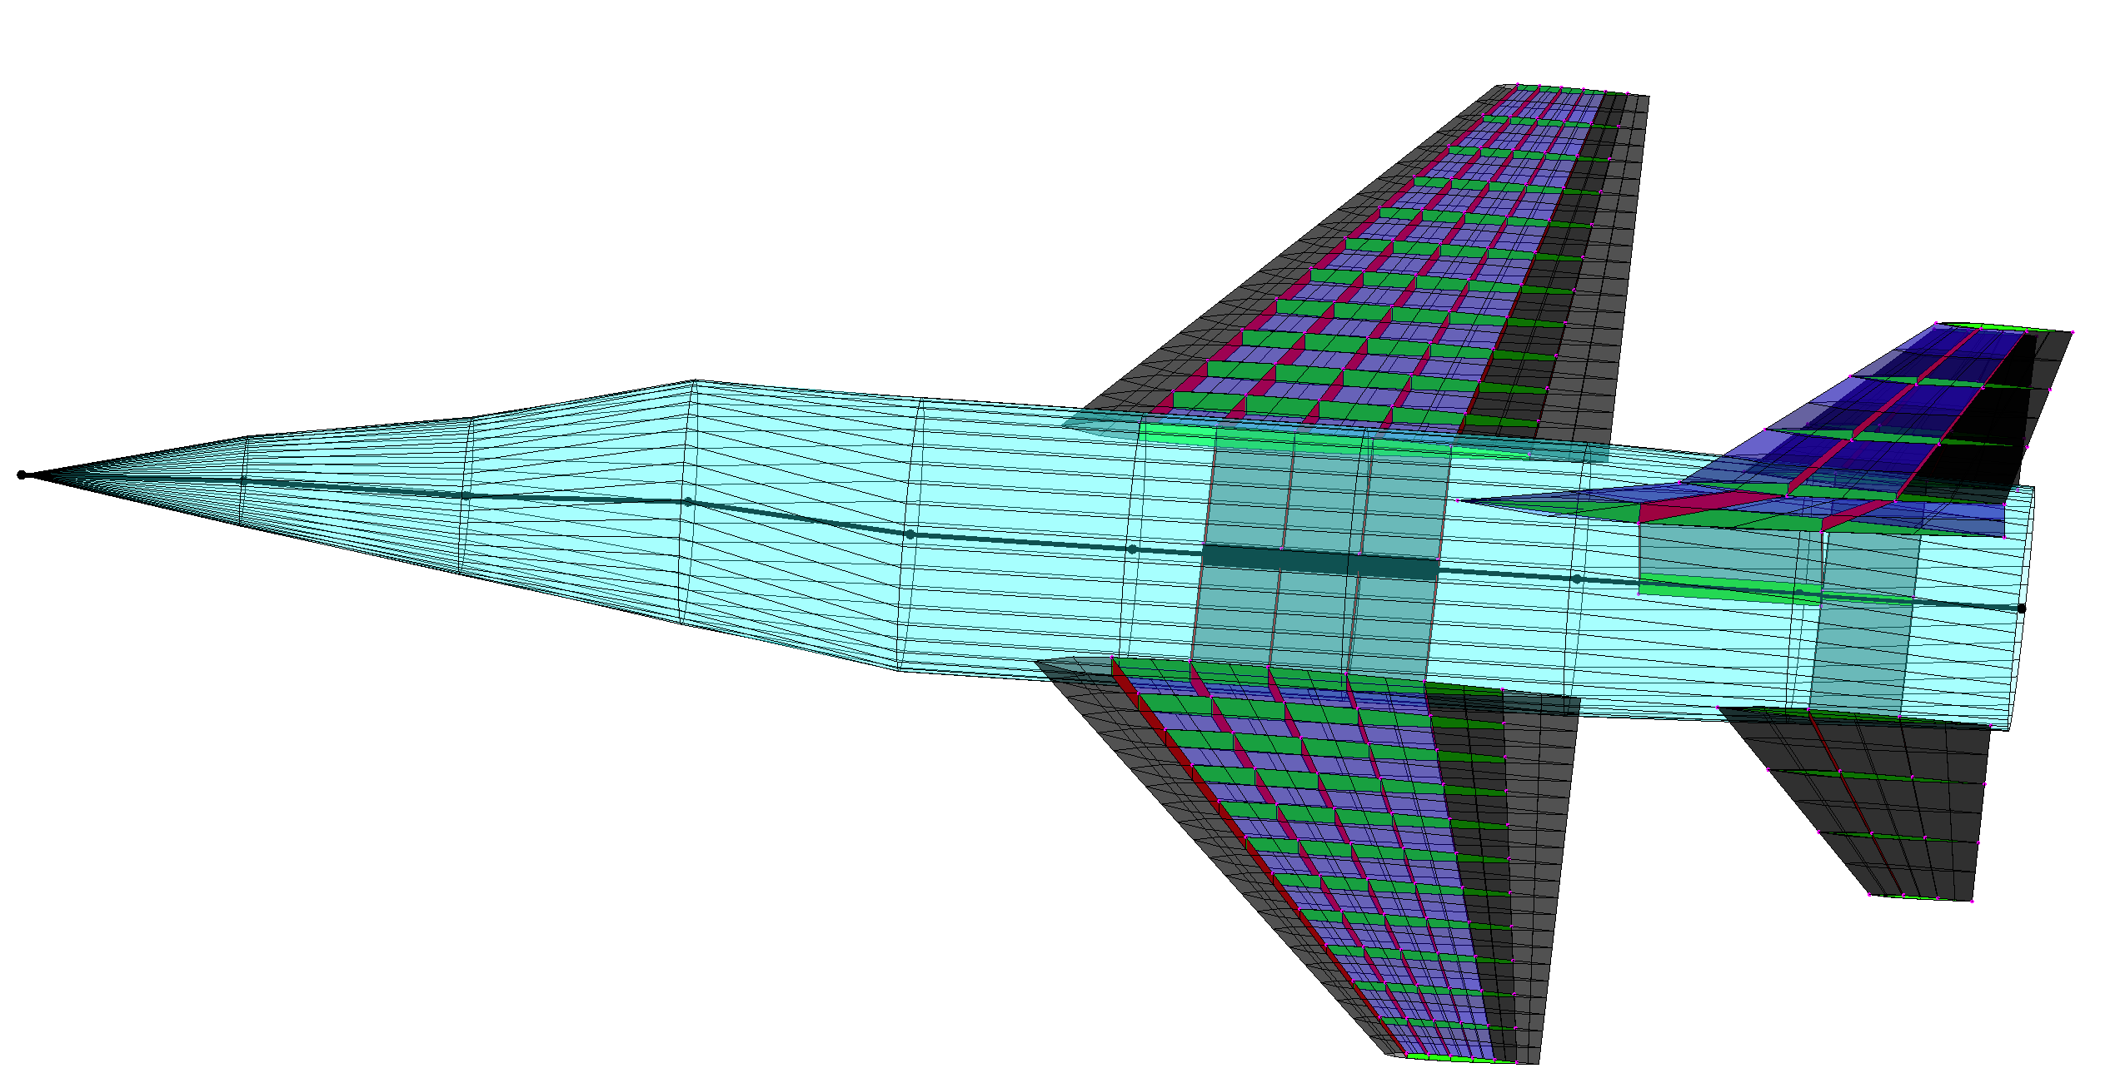
Introduction
MSTC and 6th Generation Fighter
Physics-based analyses
Integrated MDA
Multidisciplinary optimization (MDO) algorithms
Process integration and design optimization software: SORCER
ESAV Baseline
Small, single engine fighter
~30k lb TOGW
~25k lb thrust engine
ESAV MDA in SORCER
Geometry generation
Aerodynamics
Aeroelasticity
Structural mechanics
Performance
Notes:
The ESAV MDA involves many analysis codes, which are integrated using SORCER.

Slide 4
Area, Taper Ratio,
& Aspect Ratio
Geometry
(MSTCGEOM)
Wave Drag
(AWAVE)
Aeroelasticity (ASTROS)
Viscous & Profile Drag (FRICTION)
Subsonic Induced Drag (TORNADO)
Supersonic Induced Drag (WINGDES)
Performance (MSTCPERF)
Range & Weight
Notes:
This is the ESAV N-squared analysis diagram.

Slide 5
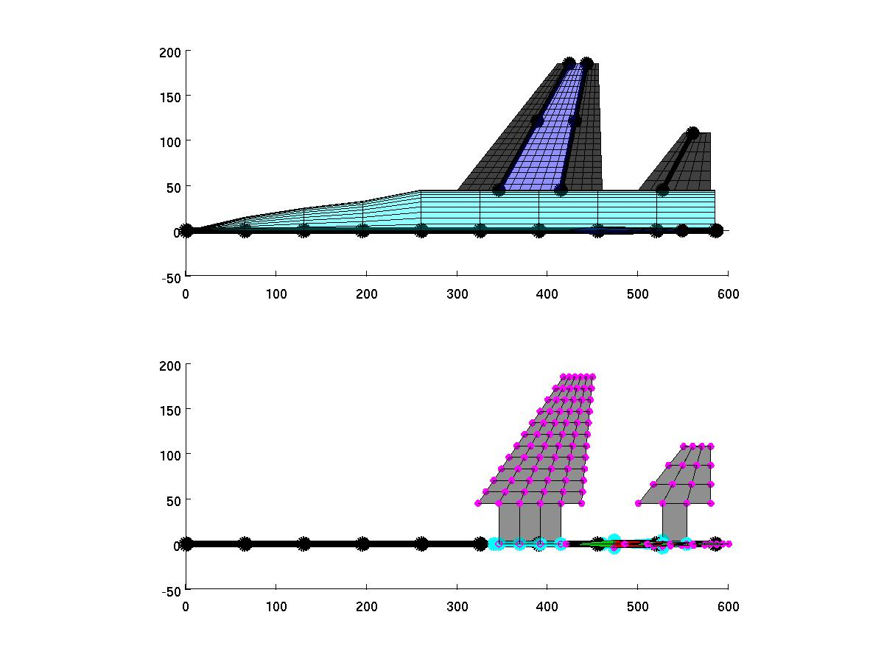
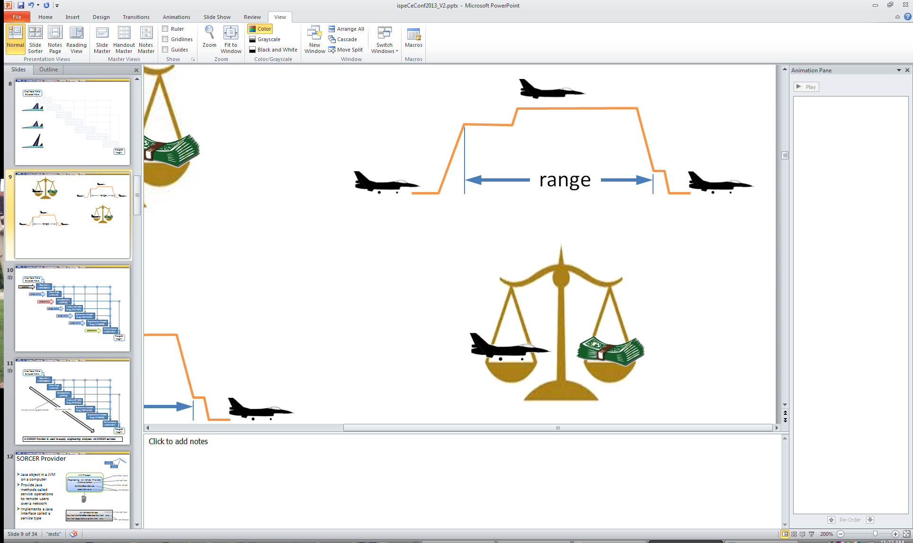
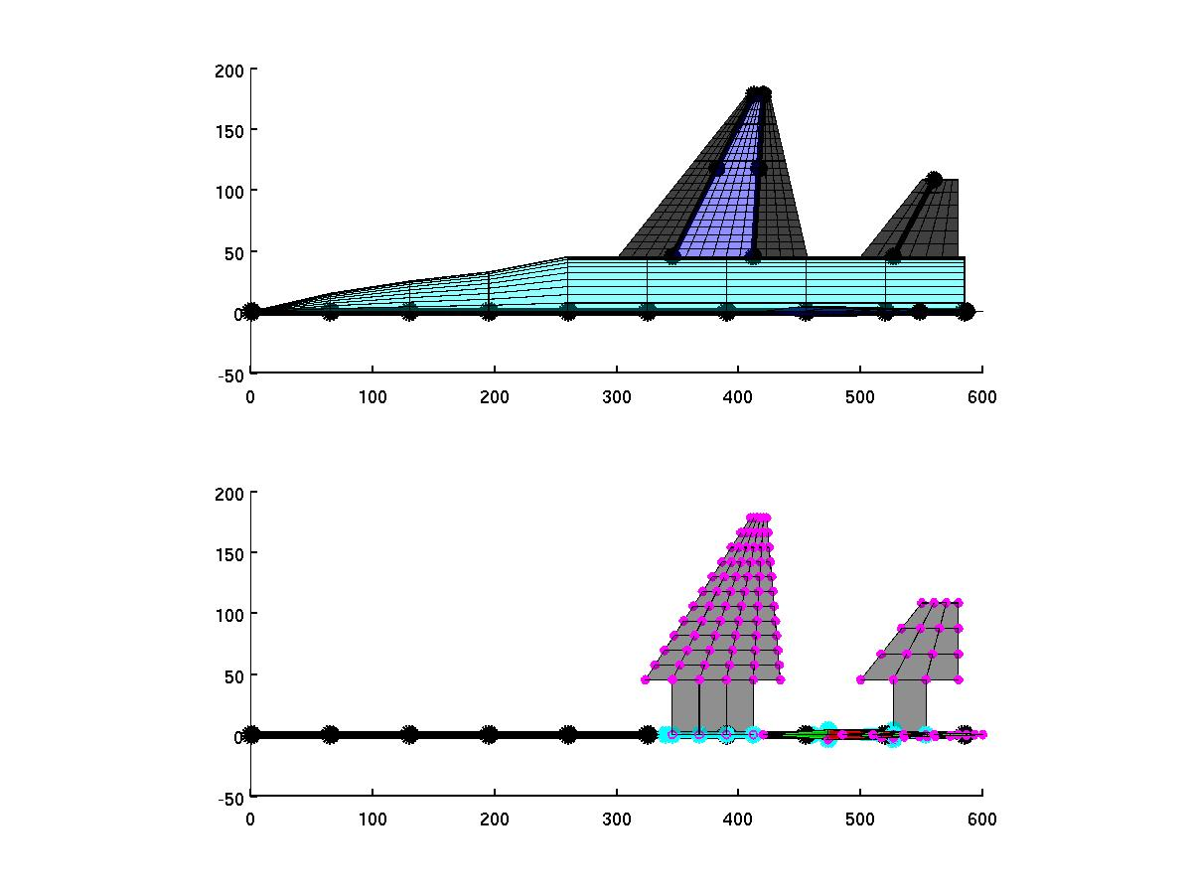
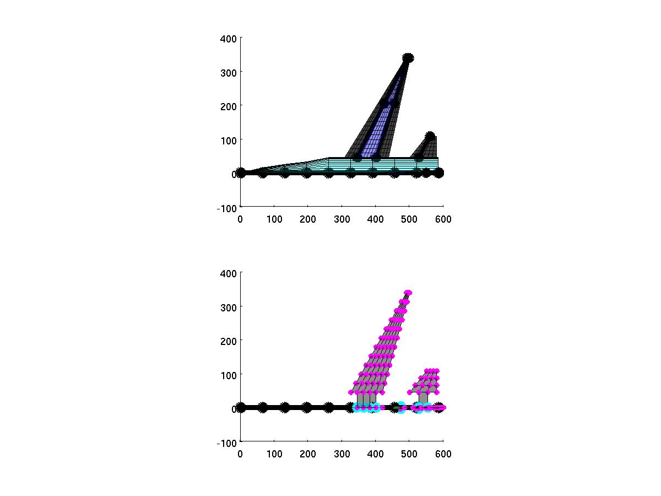
Area, Taper Ratio,
& Aspect Ratio
Geometry
(MSTCGEOM)
Wave Drag
(AWAVE)
Aeroelasticity (ASTROS)
Viscous & Profile Drag (FRICTION)
Subsonic Induced Drag (TORNADO)
Supersonic Induced Drag (WINGDES)
Performance (MSTCPERF)
Range & Weight
Notes:
This is the ESAV N-squared analysis diagram.

Slide 6
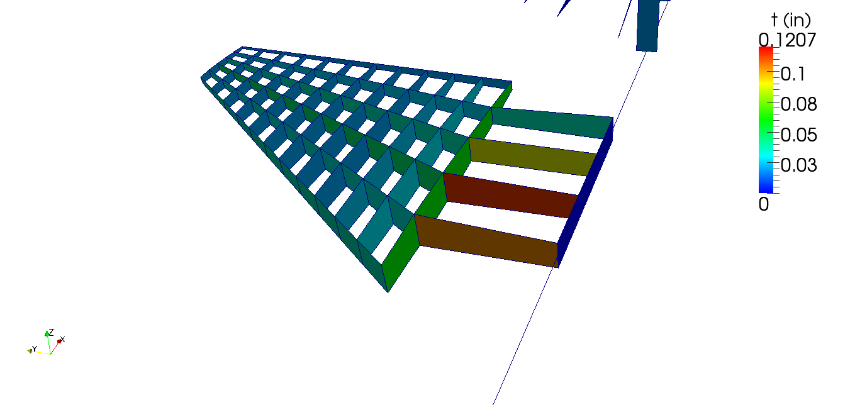
Area, Taper Ratio,
& Aspect Ratio
geometry
Geometry
(MSTCGEOM)
aerodynamics
Wave Drag
(AWAVE)
aeroelasticity
Aeroelasticity (ASTROS)
weight
aerodynamics
Viscous & Profile Drag (FRICTION)
Skin, ribs and spars structural sizing optimization
Subsonic Induced Drag (TORNADO)
aerodynamics
aerodynamics
Supersonic Induced Drag (WINGDES)
performance
Performance (MSTCPERF)
range
Range & Weight
Notes:
Thing to note here is that there are 7 engineering analysis codes which include:
geometry generation, aerodynamic, aeroelastic, and performance analysis;
Four maneuver load cases for ASTROS structural sizing optimization: 9g pull at Mach 0.9; 7.2g pull at Mach 1.2; 3g push at Mach 1.2; and anti-symmetric 100 deg/s aileron roll at Mach 1.2.
~10 min per analysis
A SORCER Provider is used to supply engineering analyses via SORCER services.

Slide 7
Area, Taper Ratio,
& Aspect Ratio
Geometry
(MSTCGEOM)
Wave Drag
(AWAVE)
Aeroelasticity (ASTROS)
Viscous & Profile Drag (FRICTION)
~10 min per MDA
Subsonic Induced Drag (TORNADO)
Supersonic Induced Drag (WINGDES)
Performance (MSTCPERF)
Range & Weight

Slide 8
SORCER ESAV Entities
Area, Taper Ratio,
& Aspect Ratio
Geometry
(MSTCGEOM)
Geometry
(MSTCGEOM)
Wave Drag
(AWAVE)
Wave Drag
(AWAVE)
Aeroelasticity (ASTROS)
Aeroelasticity (ASTROS)
Viscous & Profile Drag (FRICTION)
Viscous & Profile Drag (FRICTION)
Subsonic Induced Drag (TORNADO)
Subsonic Induced Drag (TORNADO)
Supersonic Induced Drag (WINGDES)
Supersonic Induced Drag (WINGDES)
Performance (MSTCPERF)
Performance (MSTCPERF)
Range & Weight
Notes:
The N2 diagram is implemented in SORCER via two primary entities: the Service Provider and the Model.

Slide 9
SORCER ESAV Entities
Area, Taper Ratio,
& Aspect Ratio
Engineering ESAV Model
Geometry
(MSTCGEOM)
Wave Drag
(AWAVE)
AirVehicle Provider
Aeroelasticity (ASTROS)
Viscous & Profile Drag (FRICTION)
Geometry
(MSTCGEOM)
Subsonic Induced Drag (TORNADO)
Wave Drag
(AWAVE)
Supersonic Induced Drag (WINGDES)
Aeroelasticity (ASTROS)
Performance (MSTCPERF)
Viscous & Profile Drag (FRICTION)
Range & Weight
Subsonic Induced Drag (TORNADO)
Supersonic Induced Drag (WINGDES)
Performance (MSTCPERF)

Slide 10
SORCER ESAV Entities
independent vars
Area, Taper Ratio,
& Aspect Ratio
Engineering ESAV Model
Geometry
(MSTCGEOM)
Wave Drag
(AWAVE)
AirVehicle Provider
Aeroelasticity (ASTROS)
Viscous & Profile Drag (FRICTION)
Geometry
(MSTCGEOM)
Subsonic Induced Drag (TORNADO)
Wave Drag
(AWAVE)
Supersonic Induced Drag (WINGDES)
Aeroelasticity (ASTROS)
Performance (MSTCPERF)
Viscous & Profile Drag (FRICTION)
Range & Weight
Subsonic Induced Drag (TORNADO)
Supersonic Induced Drag (WINGDES)
dependent vars
Performance (MSTCPERF)

Slide 11
SORCER ESAV Entities
Area, Taper Ratio,
& Aspect Ratio
Engineering ESAV Model
Geometry
(MSTCGEOM)
Wave Drag
(AWAVE)
AirVehicle Provider
Aeroelasticity (ASTROS)
Viscous & Profile Drag (FRICTION)
Geometry
(MSTCGEOM)
Subsonic Induced Drag (TORNADO)
Wave Drag
(AWAVE)
Supersonic Induced Drag (WINGDES)
Aeroelasticity (ASTROS)
Performance (MSTCPERF)
Viscous & Profile Drag (FRICTION)
Range & Weight
Subsonic Induced Drag (TORNADO)
Supersonic Induced Drag (WINGDES)
service operations
Performance (MSTCPERF)
Several AirVehicle Providers are published on different computers to do parallel Space Computing...
Notes:
The linking of each physics-based analysis and data flow are implemented in a SORCER Model.
All the physics-based analyses required for the ESAV MDA are implemented in a single SORCER Provider called the AirVehicle Provider.
Each blue box represents a Java-wrapped native executable required of the ESAV MDA and is referred to as a service operation.

Slide 12
SORCER Space Computing
Parallel grid computing via JavaSpaces technology
Space is published as a provider
Space is repository for tasks
Providers watch space for tasks with their service type
Tasks are dropped into space by clients
Providers pick-up, process, and return completed tasks to space
Clients retrieve completed tasks
SORCER Space computing is a reliable, dynamically scalable, self-load balancing, distributed computing system.

Slide 13
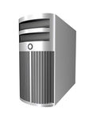
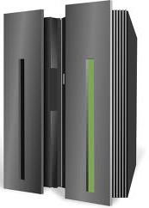

Engineering Air Vehicle Provider
JavaSpace
worker threads
Engineering Air Vehicle Provider
worker threads
Engineering Air Vehicle Provider
Engineering ESAV Model Provider
…
worker thread
Independent
var: area
Matlab Client
MSTCPERF task
var: range
network

Slide 14
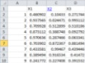
Engineering Air Vehicle Provider
JavaSpace
worker threads
Engineering Air Vehicle Provider
worker threads
Engineering Air Vehicle Provider
Engineering ESAV Model Provider
…
worker thread
Independent
var: area
Matlab Client
MSTCPERF task
var: range
new models for parallel table execution
[X]
network

Slide 15
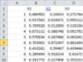
Engineering Air Vehicle Provider
JavaSpace
worker threads
Engineering Air Vehicle Provider
worker threads
Engineering Air Vehicle Provider
Engineering ESAV Model Provider
…
worker thread
Independent
var: area
Matlab Client
MSTCPERF task
var: range
new models for parallel table execution
[X Y]
[X]
network

Slide 16
ESAV SORCER Demo
Wing Optimization Problem
Minimize weight
Design variables
Wing area
Aspect ratio
Structural sizing properties
One constraint
1400 mi range minimum
Robust successive linear programming (SLP) algorithm
Notes:
Range is calculated for an optimal altitude trajectory.

Slide 17
DEMO
Notes:
Range is calculated for an optimal altitude trajectory.

Slide 18
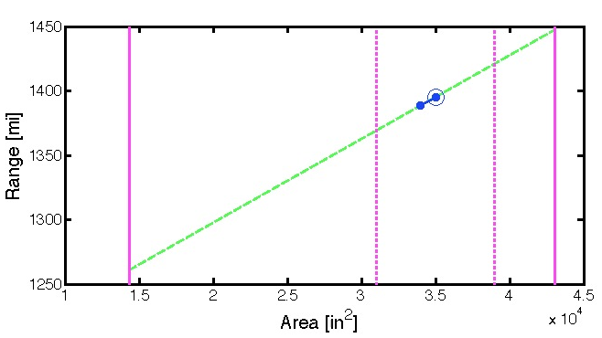
ESAV SORCER Demo
Robust SLP Algorithm
First-things first: Parameter studies
Vet MDA
Finite-difference step sizes
SLP move limits
Gradient calculations
High-order central differences
Parallel
Linear programming solution subject to move limits
Line search, sort of
Partial enumeration of line
Parallel
Visual feedback
LP solution
ALPHA = 100%
x₂
x₁
linear model prediction
actual results
ALPHA = 0%
Δobjective
Notes:
Range is calculated for an optimal altitude trajectory.

Slide 19
ESAV SORCER Example
Wing Optimization Problem
Minimize weight
Subject to minimum range
6000 lb fuel burn @ Mach 0.8
Design variables
Wing area
Aspect ratio
Taper ratio
Structural sizing properties
Comments
Case 1: 1500 mi range minimum
Case 2: 2500 mi range minimum
Robust SLP algorithm
Three Linux boxes and two Macs
Notes:
Range is calculated for an optimal altitude trajectory.

Slide 20
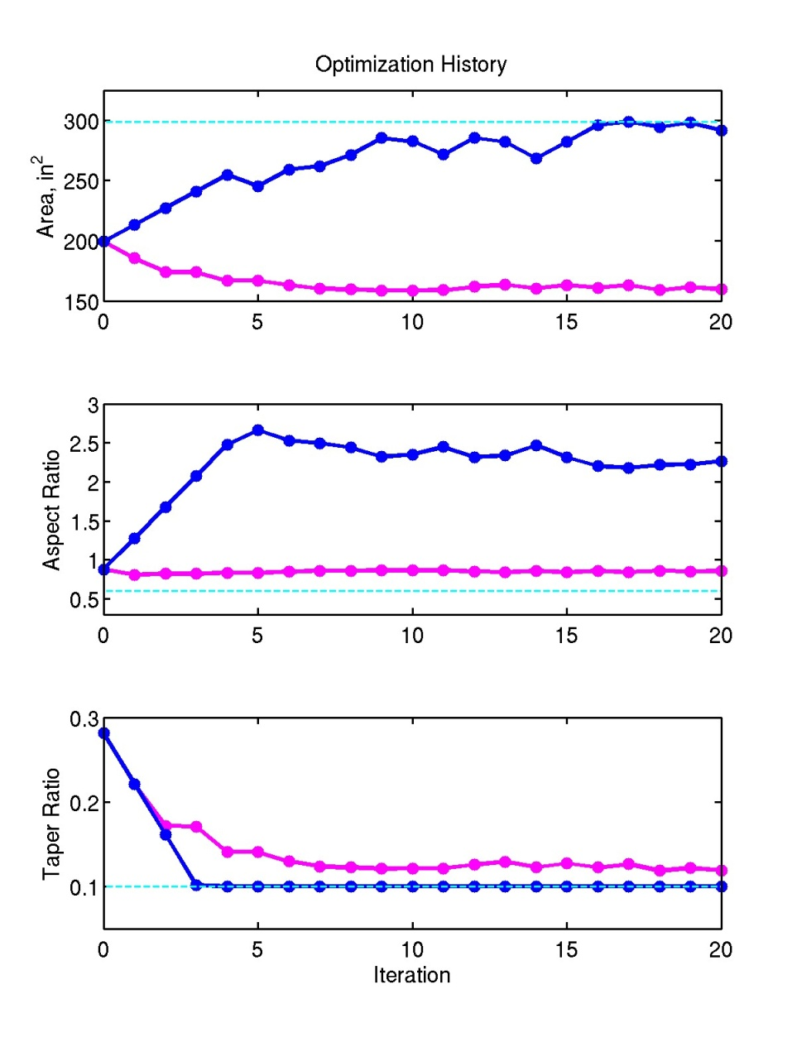
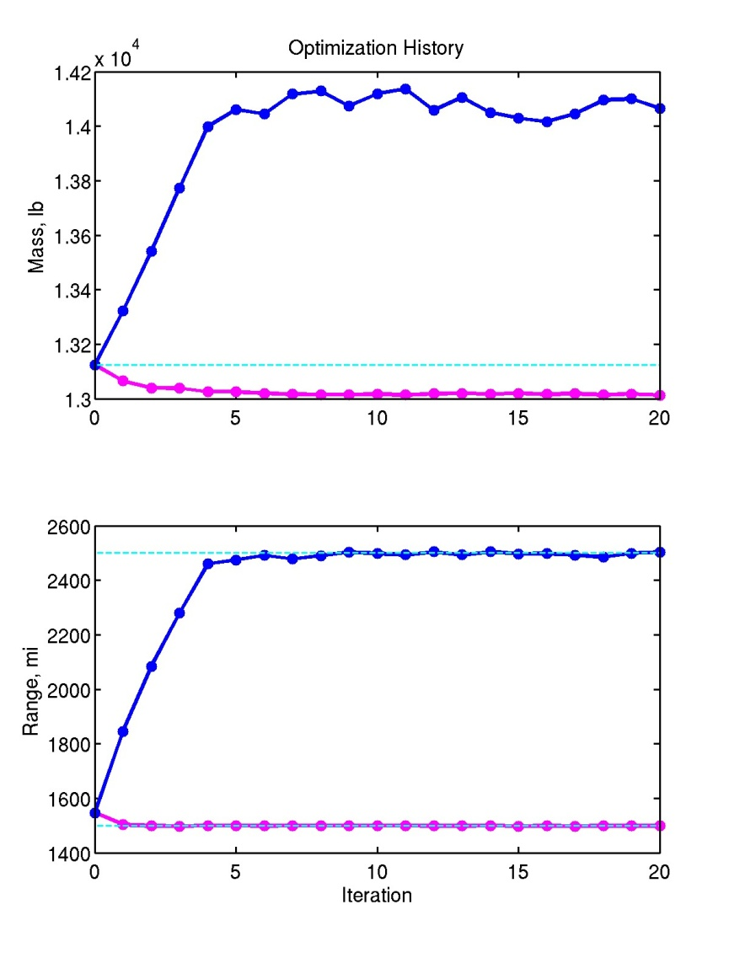

Slide 21
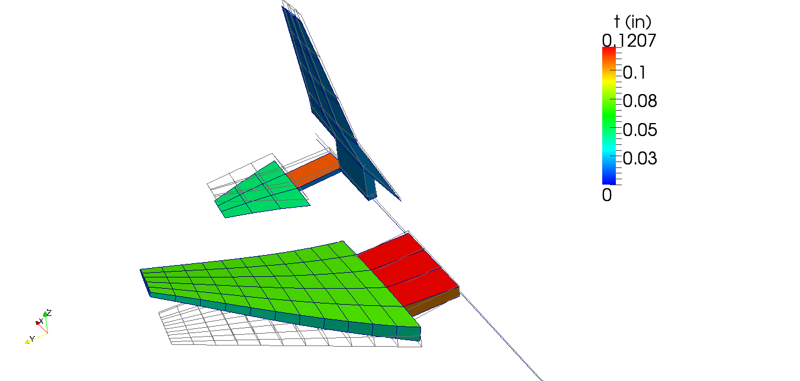
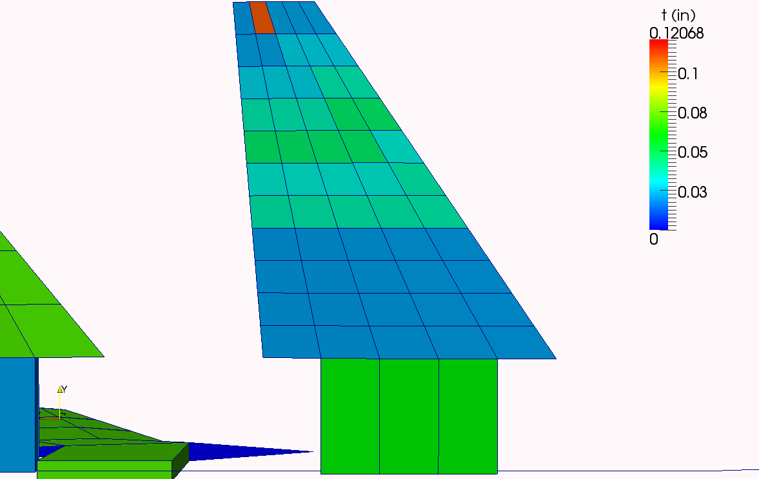
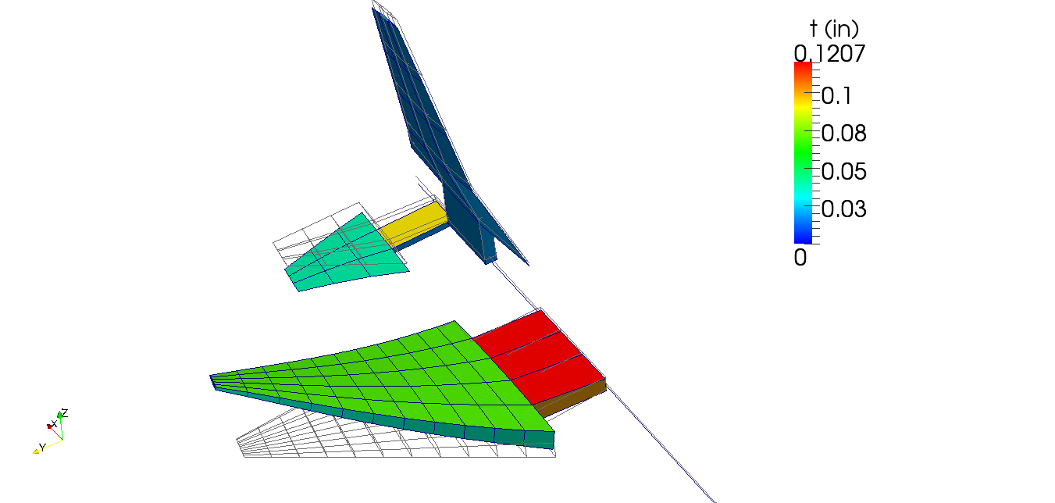
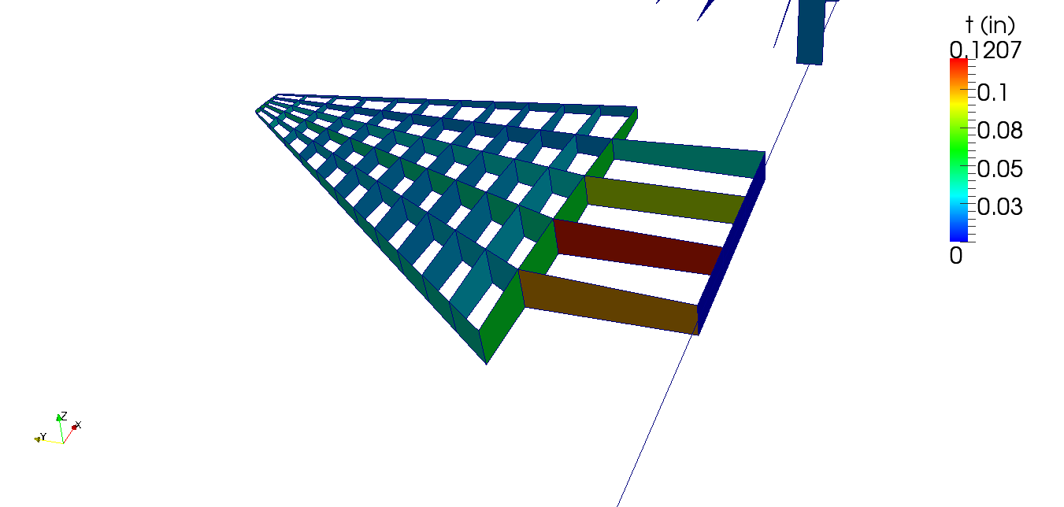
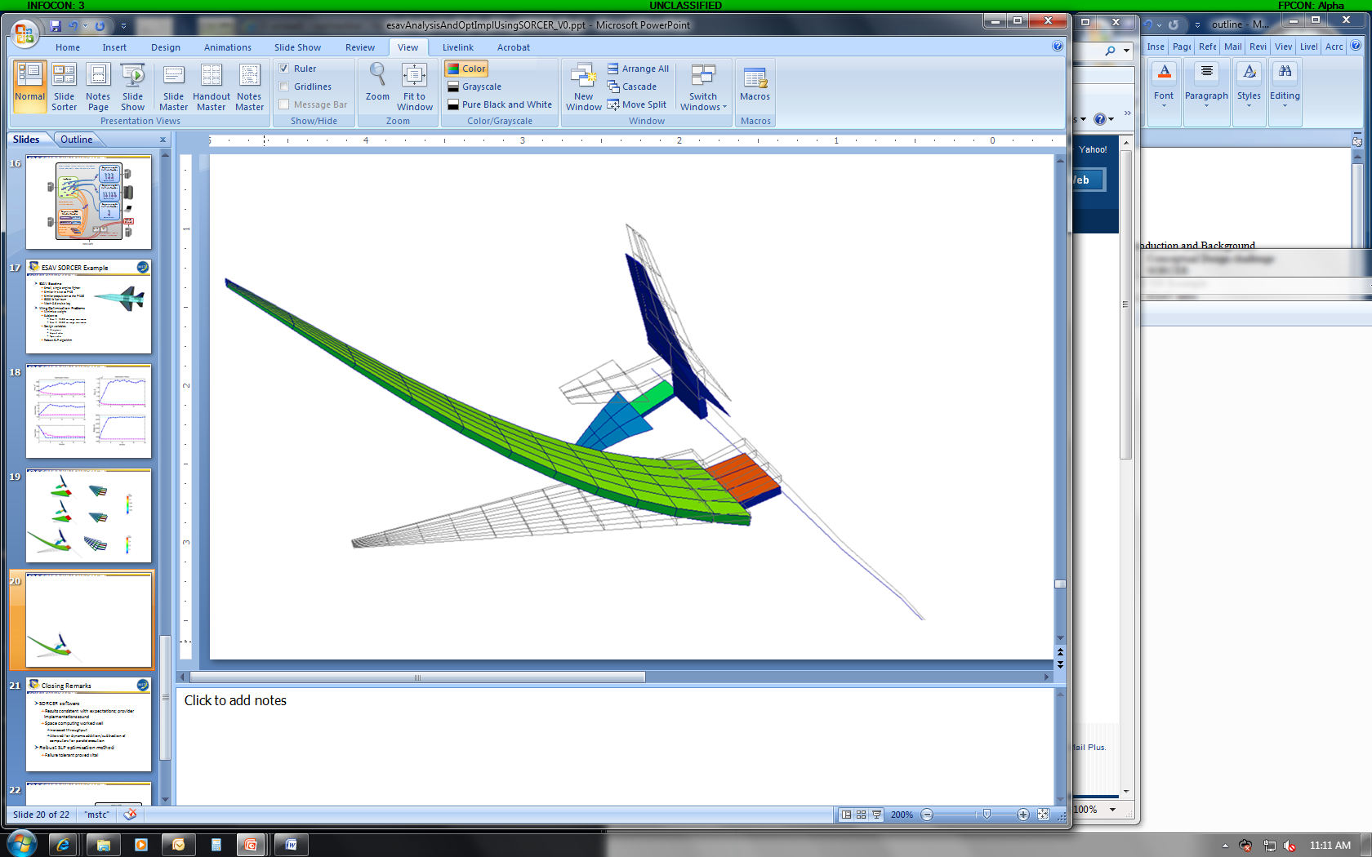
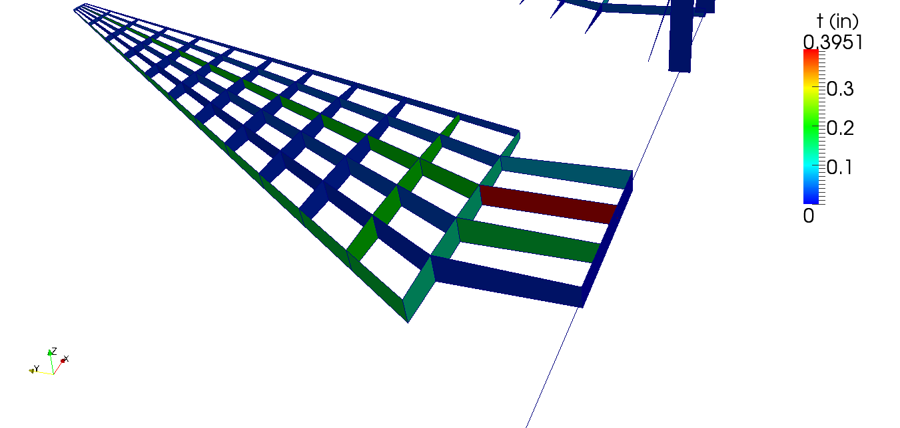
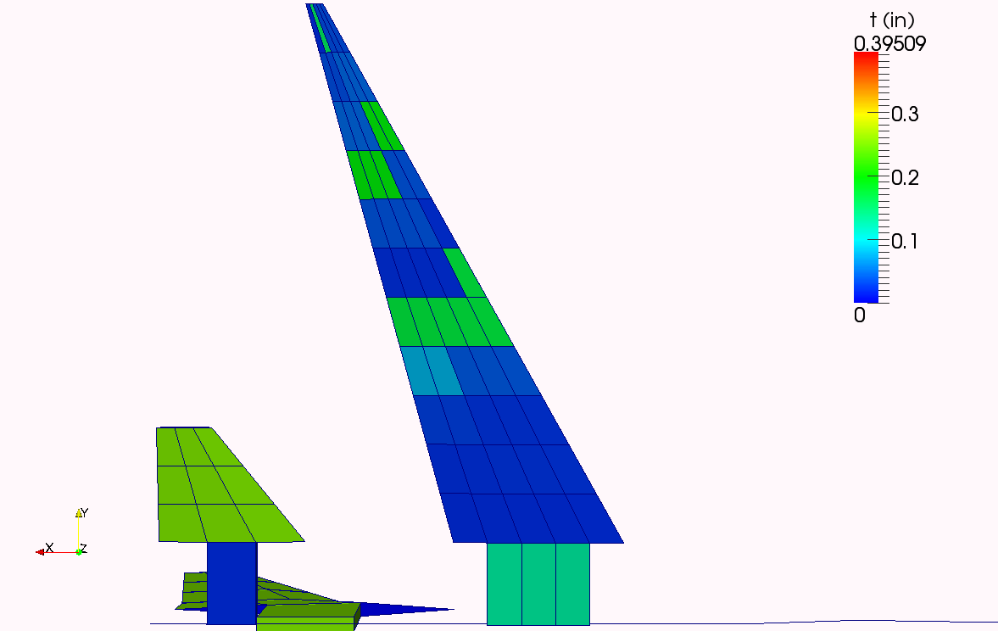

Slide 22
Closing Remarks
SLP optimization method
Worked…failure tolerance was critical
SORCER software
Results consistent with expectations; provider implementations sound
Space computing worked well
Increased throughput 5x
Allowed for dynamic addition/subtraction of computers for parallel execution
Thank You.

Slide 23
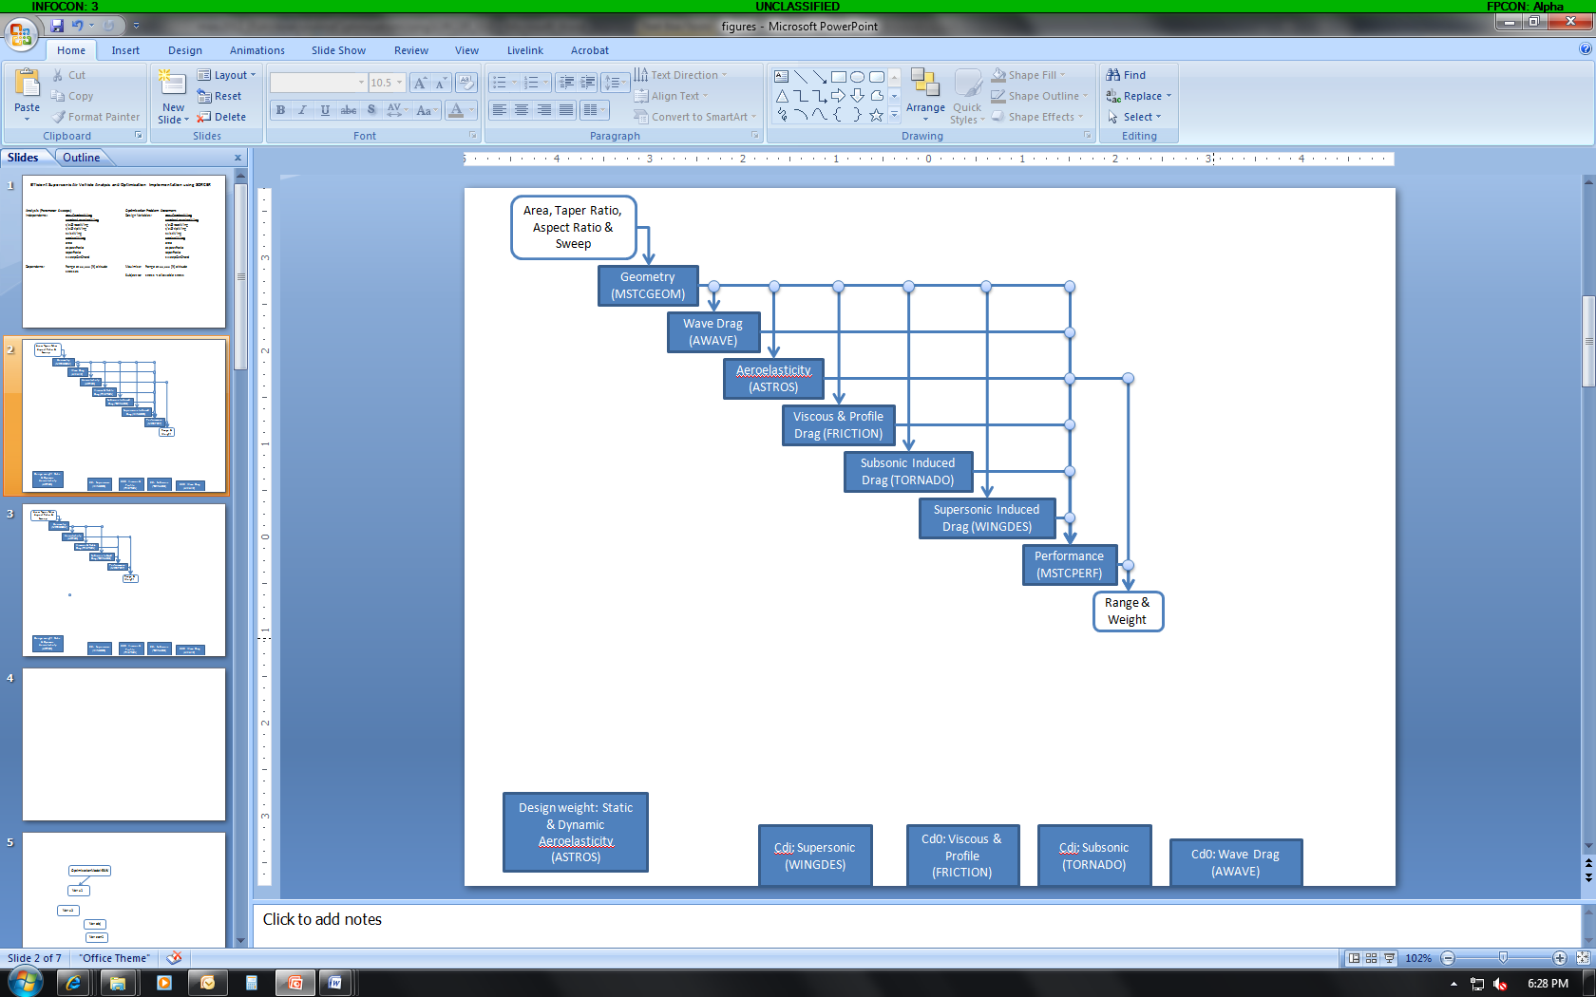
ExpressionEvaluator
expr: “X1 + X2”
network
vars: x1, x2
Java Virtual Machine Process
evaluator value
Engineering Air Vehicle Provider
doMstcGeomService
executeAwave
IndependentEvaluator
evaluator value

Slide 24
SORCER Overview
SORCER Tasks
Client-side object to use remote services
Contains
Signature
Service type
Service
Provider name (optional)
Context
Client calls method on task to execute
Task
Signature
Context
Engineering Air Vehicle Provider
doMstcGeomService
executeAwave
Tasks use remote services to do calculations; Evaluators do local and remote.

Slide 25
Engineering Air Vehicle Provider
JavaSpace
worker threads
Engineering Air Vehicle Provider
worker threads
Engineering Air Vehicle Provider
Engineering ESAV Model Provider
…
worker thread
Independent
var: area
Matlab Client
MSTCPERF task
var: range
new models for parallel table execution
[X Y]
[X]
network

Slide 26
analysis provider thread takes tasks for its worker threads; when work is done, puts back into space
Engineering Air Vehicle Provider
JavaSpace
worker threads
Engineering Air Vehicle Provider
worker threads
models writing/taking tasks to/from space
Engineering Air Vehicle Provider
Engineering ESAV Model Provider
…
worker thread
Independent
var: area
Matlab Client
MSTCPERF task
var: range
new models for parallel table execution
[X Y]
[X]
matlab submits table to model via Java method
network

Slide 27
SORCER ESAV Implementation
ESAV MDA - SORCER Air Vehicle Provider
All services are available in one provider
ESAV MDA Model
Xs: wing design variables
Ys: range and weight
ESAV MDO - Matlab
Objective & constraints via SORCER ModelClient
Notes
SORCER can drive or be driven
SORCER clients can be Java, command-line, or shell script

Slide 28

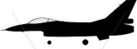
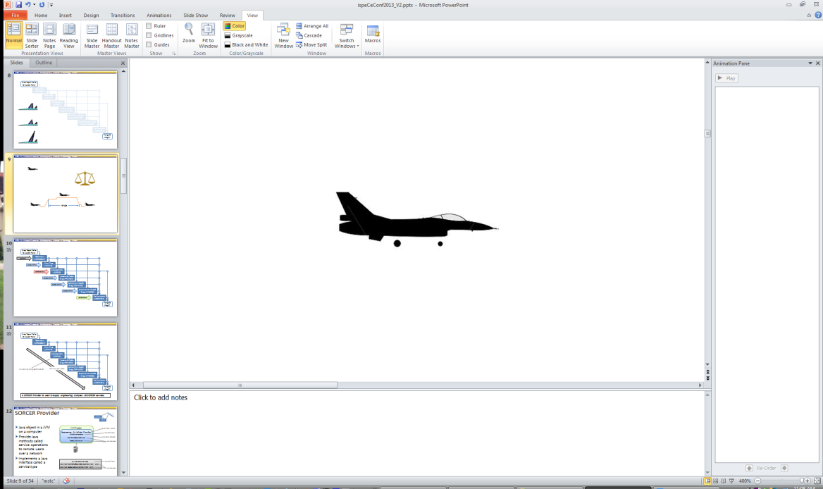



range
range

Slide 29
Area, Taper Ratio,
& Aspect Ratio
geometry
Geometry
(MSTCGEOM)
aerodynamics
Wave Drag
(AWAVE)
aeroelasticity
Aeroelasticity (ASTROS)
aerodynamics
Viscous & Profile Drag (FRICTION)
aerodynamics
Subsonic Induced Drag (TORNADO)
aerodynamics
Supersonic Induced Drag (WINGDES)
performance
Performance (MSTCPERF)
Range & Weight
Notes:
Thing to note here is that there are 7 engineering analysis codes which include:
geometry generation, aerodynamic, aeroelastic, and performance analysis;
Four maneuver load cases for ASTROS structural sizing optimization: 9g pull at Mach 0.9; 7.2g pull at Mach 1.2; 3g push at Mach 1.2; and anti-symmetric 100 deg/s aileron roll at Mach 1.2.
~10 min per analysis
A SORCER Provider is used to supply engineering analyses via SORCER services.

Slide 30
ESAV Analysis via Space Computing Demo
independent vars
Area, Taper Ratio,
& Aspect Ratio
Engineering ESAV Model
Geometry
(MSTCGEOM)
Wave Drag
(AWAVE)
intermediate vars
AirVehicle Provider
Aeroelasticity (ASTROS)
Viscous & Profile Drag (FRICTION)
Geometry
(MSTCGEOM)
Subsonic Induced Drag (TORNADO)
Wave Drag
(AWAVE)
service type & operation
Supersonic Induced Drag (WINGDES)
Aeroelasticity (ASTROS)
Performance (MSTCPERF)
Viscous & Profile Drag (FRICTION)
Range & Weight
Subsonic Induced Drag (TORNADO)
Supersonic Induced Drag (WINGDES)
dependent vars
Performance (MSTCPERF)

Slide 31
Introduction and Background
SORCER (Service-Oriented Computing Environment)
Java-based code developed at AFRL
Service-oriented
Open flexible design
Allows the incorporation of existing methods and data as services
Provides a common way to model analyses and design processes
Network-based, distributed framework
Services are discovered with Java Jini technology
Supports collaboration among geographically distributed engineering and business partners
Supports parallel computing via JavaSpaces technology
Notes:
SORCER is used at AFRL MSTC for ESAV studies.

Slide 32
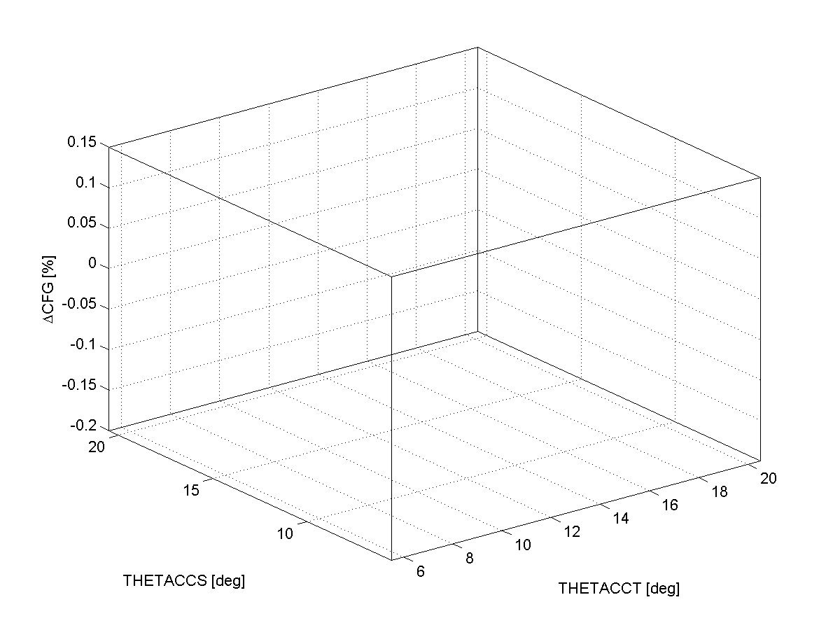
LP Example

Slide 33
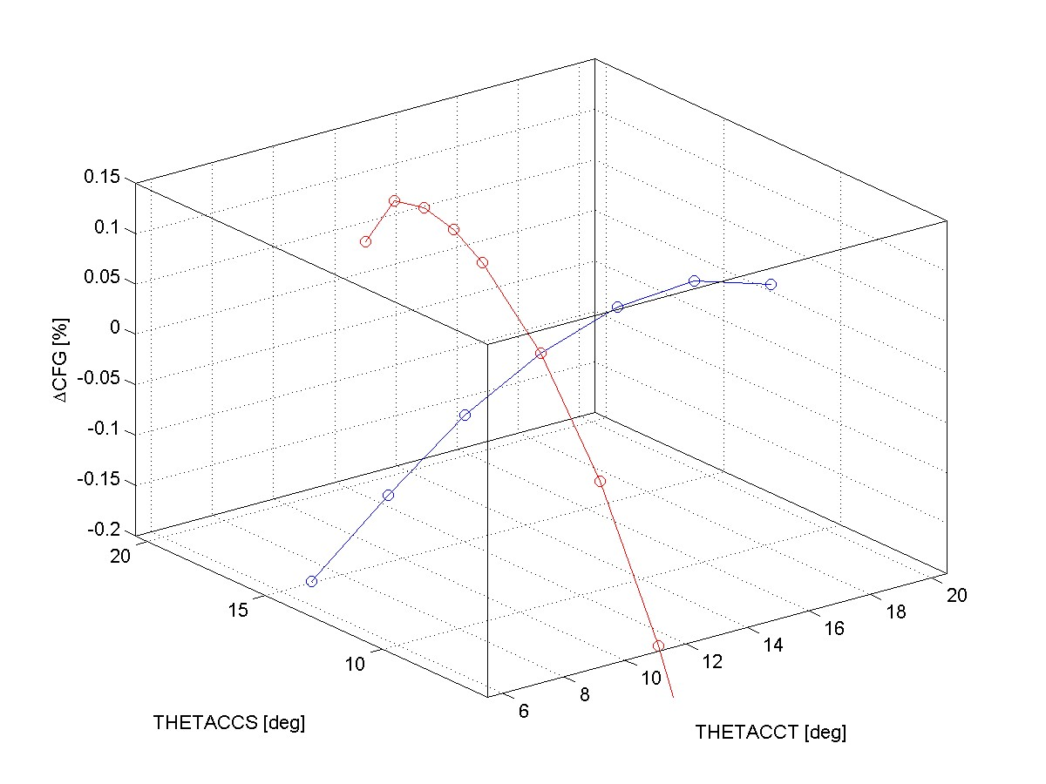
DV Sweep

Slide 34
Gradient

Slide 35
Gradient

Slide 36
DV Bounds
DV Bounds

Slide 37
DV Bounds

Slide 38
LP Solution

Slide 39
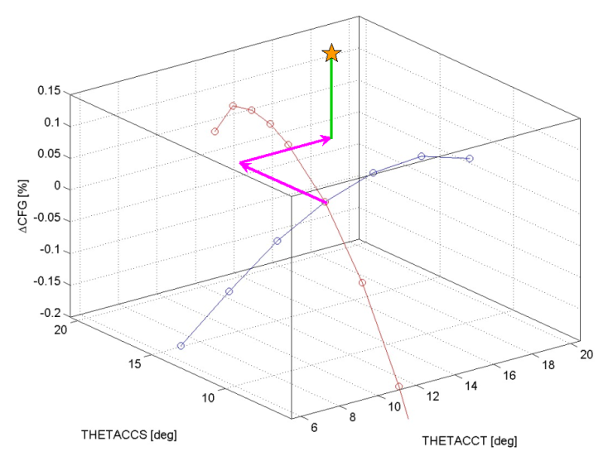
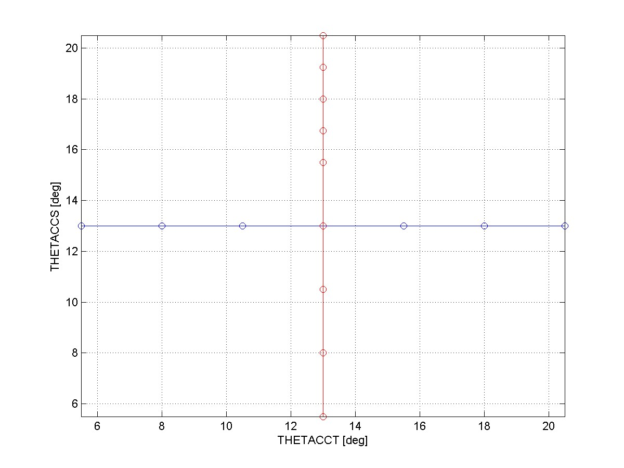
LP Solution

Slide 40
Line Search
ALPHA = 100%
ALPHA = 0%

Slide 41
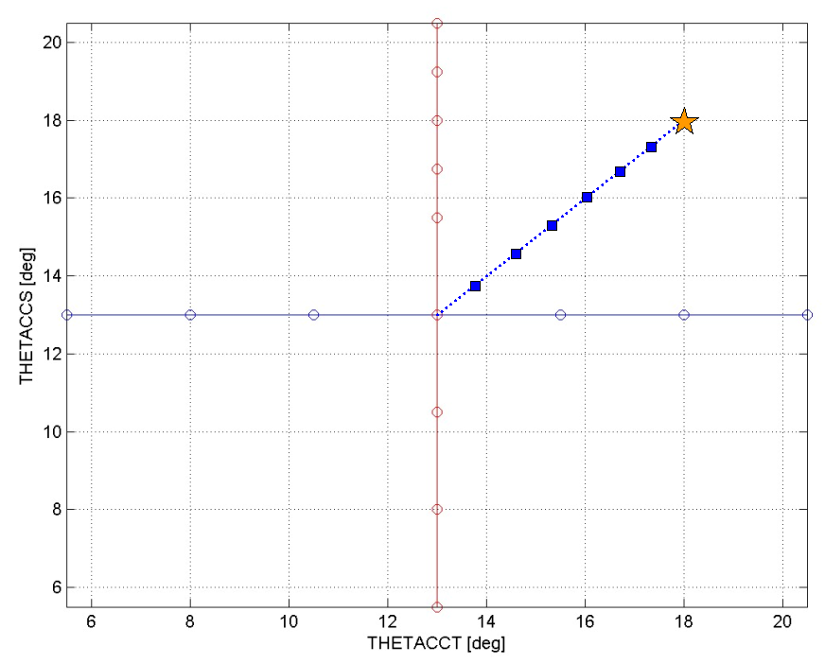
Line Search

Slide 42
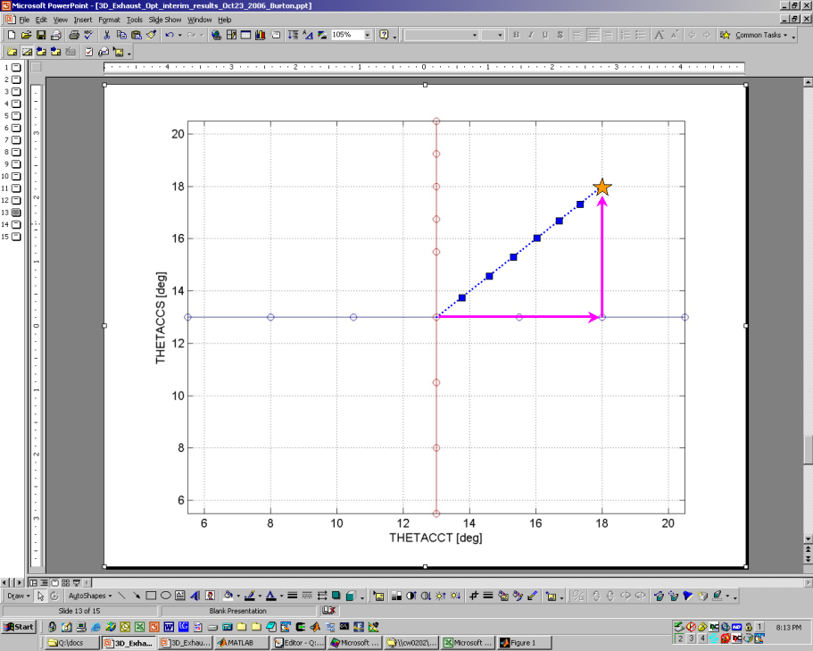
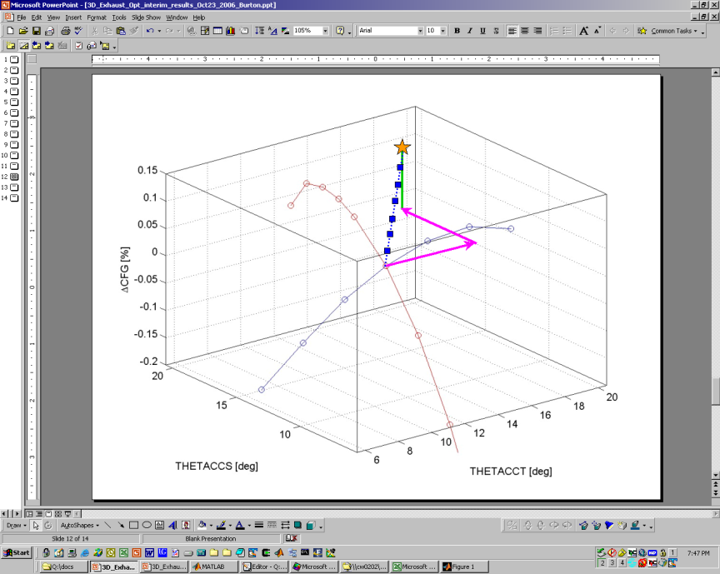
Line Search
ALPHA = 100%
linear model prediction
CFX results
ALPHA = 0%
ΔCFG [%]

Slide 43
Introduction and Background
Air Force Research Lab’s (AFRL) Multidisciplinary Science and Technology Center (MSTC)
Efficient supersonic air vehicle (ESAV)
Next generation fighter
Research areas
Multidisciplinary analysis
Multidisciplinary optimization
Design processes and software
The conceptual design process is key in obtaining performance and affordability.
Notes:
The conceptual design process is key in obtaining performance and affordability.

Slide 44
Introduction and Background
Conceptual design (CD)
Determines most of air vehicle cost
Many configurations analyzed
Low fidelity tools
Closed-form equations
Statistical models
Higher fidelity CD
Increased computational expense
Increased number of engineering analysis codes
Increased complexity in process integration
Need conceptual design process to handle higher fidelity analyses…SORCER.
Notes:
Low fidelity tools can miss critical physics
Need conceptual design process to handle higher fidelity analyses…SORCER.

Slide 45
SORCER Services
return value type
argument type
Java methods
Engineering analyses
Context in, Context out
AirVehicleInterface
Context doMstcGeomService(Context ctx);
Context executeAwave(Context ctx);

Slide 46
SORCER Services
key
value
[data type]
Java methods
Engineering analyses
Context in, Context out
input_1⬄http://input.txt [type.mstcg.input]
context
argument
Engineering Air Vehicle Provider
(AirVehicleInterface)
doMstcGeomService
executeAwave
Context
Key-value pairs
Keys define namespace
Values have SORCER data type attribute
Value
Any Java object (e.g., URL)
Provider-specific objects
return value
input_1⬄http://input.txt [type.mstcg.input]
output_1⬄http://output.txt [type.astros.input]
Notes:
Services like doMstcGeomService and executeAwave are typically not all Java code.

Slide 47
SORCER Vars
SORCER Filter
Operates on value returned from evaluator
Reduces or transforms
SORCER Persisters
Operates on value returned from filter
Sets value
Writes file
Passes to object
Var: y1
evaluator reference
filter
persister
evaluator value
y1 value
file
Var: y2
evaluator reference
filter
persister
evaluator value
y2 value
file
ExertionEvaluator
Task
Signature
Context
evaluator value
Notes:
Filters may be chained together to for a filter pipeline.

Slide 48
SORCER Provider
Java object in a JVM on a computer
Provide Java methods called service operations to remote users over a network
Implements a Java interface called a service type
JVM Process
provider name
Engineering Air Vehicle Provider
(AirVehicleInterface)
doMstcGeomService
executeAwave
service type
provider object
service ops
AirVehicleInterface
Context doMstcGeomService(Context ctx);
Context executeAwave(Context ctx);
service type
service ops
Notes:
Users don’t need to know where a provider is, nor it’s name (no host, port, or name required)

Slide 49
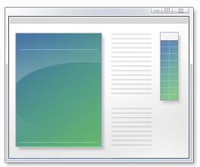
SORCER Service Operations
Typically wrap engineering analysis executables
Java service code may augment native executables
Communication
File-based
Java Native Interface (JNI)
Java Native Access (JNA)
input file
Engineering Air Vehicle Provider
doMstcGeomService
executeAwave
writes
reads
executes
reads
awave.exe
writes
output file
Notes:
SORCER services are used by clients via the Evaluator object.

Slide 50
SORCER Evaluators
Client-side object to perform calculations
ExertionEvaluator
Use remote services
Require Task object
Service type
Service op
Provider name (optional)
Context (service op argument)
ExertionEvaluator
provider name
(optional)
Task
Signature
service type
Context
service op
evaluator value
Engineering Air Vehicle Provider
(AirVehicleInterface)
doMstcGeomService
executeAwave
provider name
service type
service ops
ExertionEvaluators typically produce aggregate forms of data.
Notes:
Evaluators are used in SORCER Vars to create mathematical functions…

Slide 51
SORCER Vars
Mathematics
Independent variables
Functions
Composite functions
Demand-driven
Multi-fidelity
Objects in Vars
Evaluator
Filter
Persister
Var: y1v
evaluator reference
evaluator value
y1v value
ExertionEvaluator
ExertionEvaluator
Task
ExertionEvaluator
Task
Signature
ExertionEvaluator
Task
Signature
Context
Task
Signature
Context
multi-fidelity
evaluator value
Signature
Context
evaluator value
Context
evaluator value
evaluator value

Slide 52
SORCER Models
Collection of vars
May be published as a provider
Single model query
Set Xs, get Ys
Behaves like shared memory
Table model query
Rows of Xs
Creates new isolated model objects
Executes in parallel
OptimizationModel: model1
Var: x1v
Var: y1v
filter
Var: y2v

